Slide 1


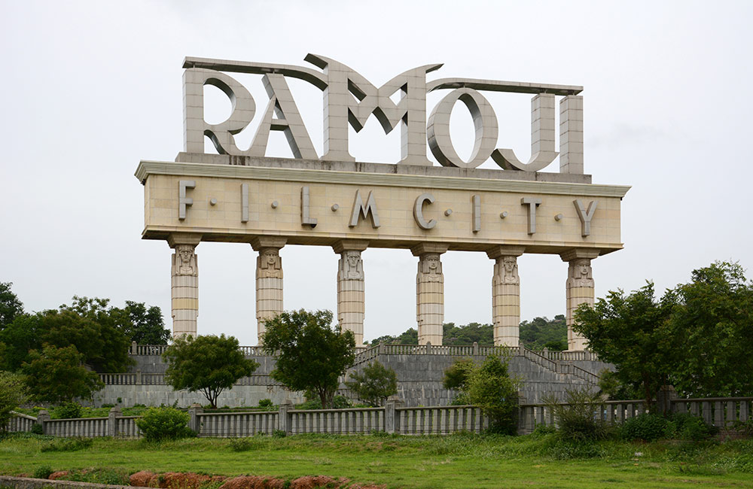

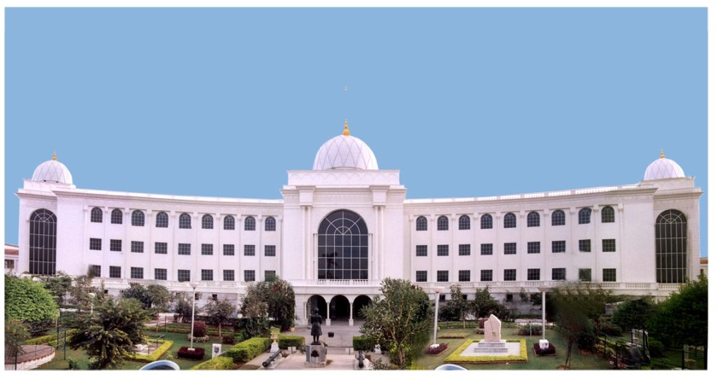
HELP ME OUT IN HYDERABAD

Slide 2
TEAM MEMBERS
2110030085 – NARRA MANAS
2110030106 – GURRAM KARYACHARAN
2110030163 – NARA BADRINATH
2110030372 – K AMITH

Slide 3
INTRODUCTION
1. Mainly we are going to create an application where the user is asked to log in with his mobile number or email this will help us trace the location of the user.
2. There will be a page where the user can ask questions related to some locations like food entertainment or famous places to visit etc.
3. Here according to the questions, we are to going display the answers to where he can go or navigate to his required location.

Slide 4
PROBLEM STATEMENT
When new people from other states or countries come to Hyderabad, then they don't know any place in Hyderabad, they face a lot of problems.
if a person who came to Hyderabad the first time and doesn’t know how to explore the city then he faces many difficulties.
Helping the people by answering their questions is the aim of this project

Slide 5
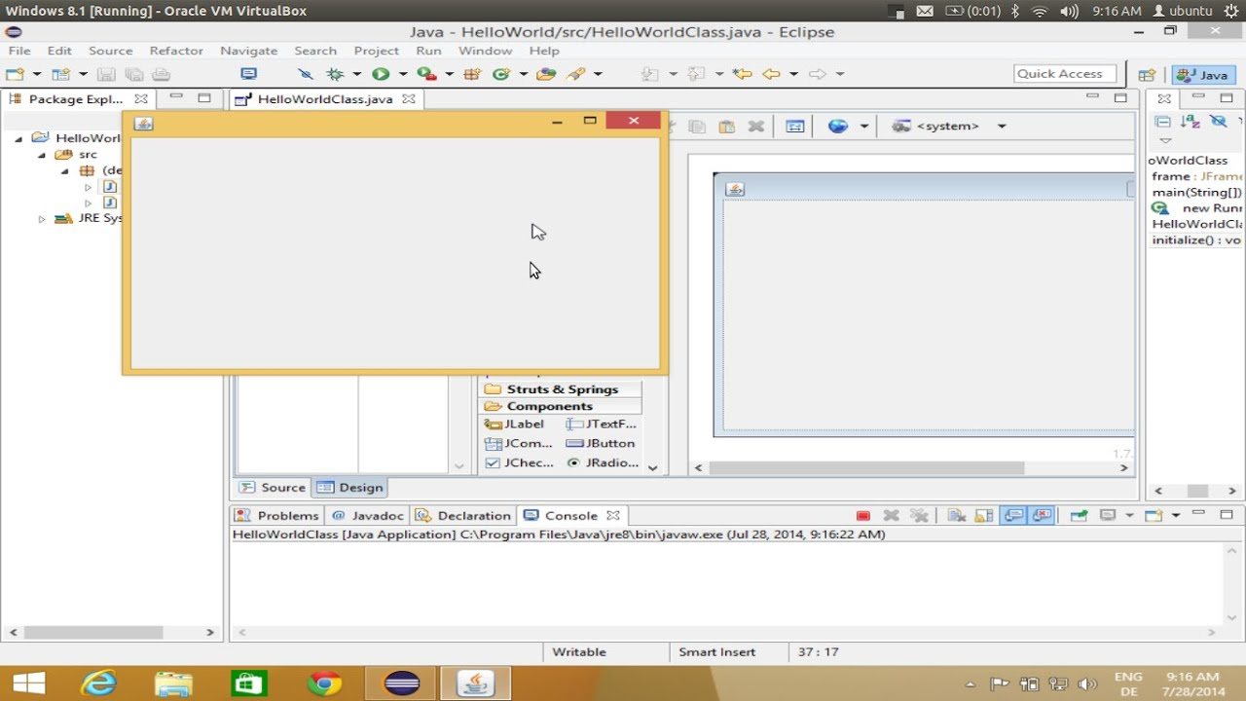
PROTOTYPE AREA
Our Prototype is an Application that tells the user what movie to watch according to the genre set by the user.
We use GUI in Java for making our Prototype.
GUI is a WindowBuilder that is composed of SWT Designer and Swing Designer and makes it very easy to create Java GUI applications without spending a lot of time writing code. Use the WYSIWYG visual designer and layout tools to create simple forms for complex windows; the Java code will be generated for you.

Slide 6
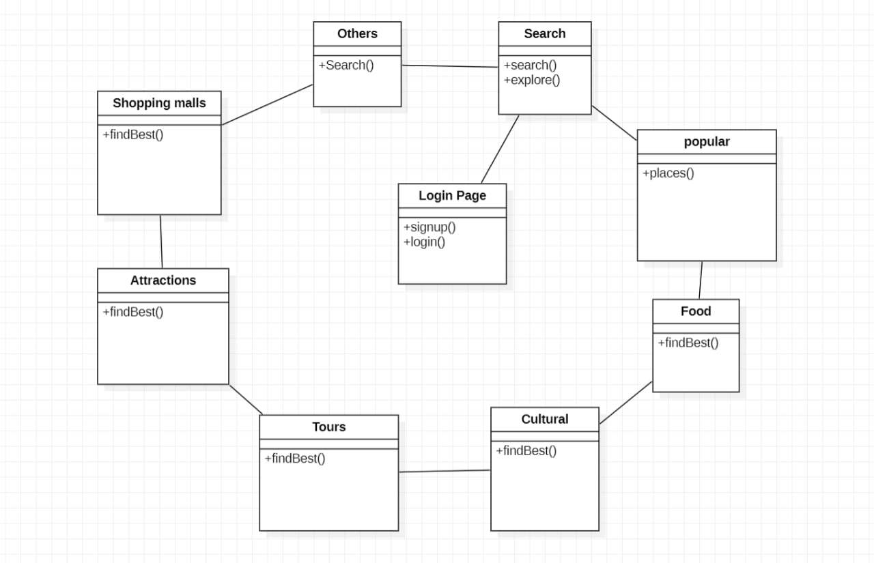
CLASS DIAGRAM

Slide 7
GITHUB SETUP
https://github.com/k-amith1610/HELP-ME-OUT-IN-HYDERABAD/tree/main/AOOP

Slide 8

THANK YOU

